Slide 1
Embedded Systems Project : AXI4-lite Prof. W. Fornaciari Prof. D. Zoni Tutor: Andrea Galimberti
Group
Colombi Marco
Corbetta Giorgio
Consonni Cesare

Slide 2
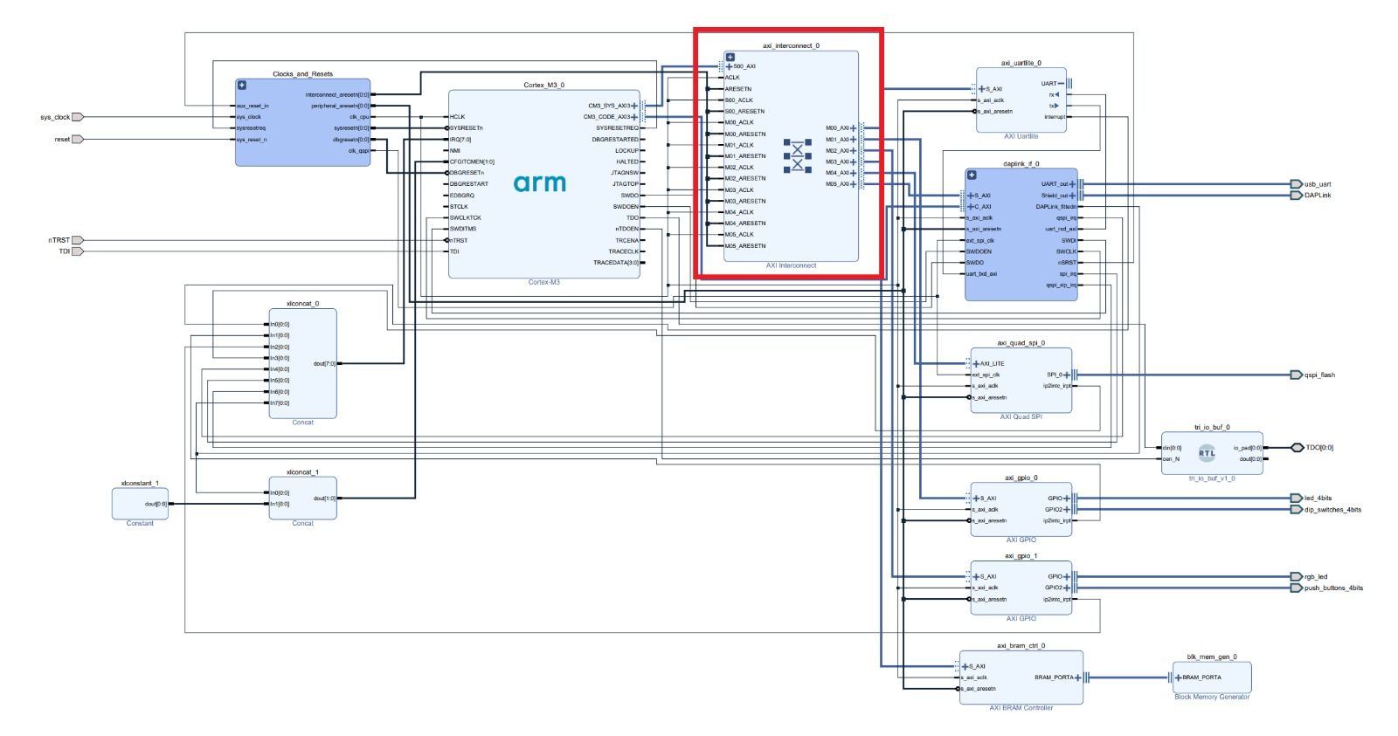

About AXI
AMBA AXI is a parallel communication protocol
multi master
multi slave
High performance
High Frequency
Used (also) inside the processors.
<number>
Notes:
Course name
Lesson name
© 2000 - Author's name
<number>

Slide 3
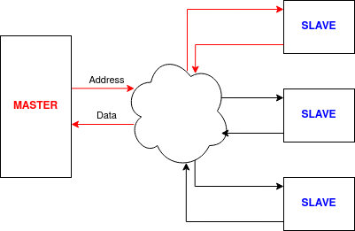
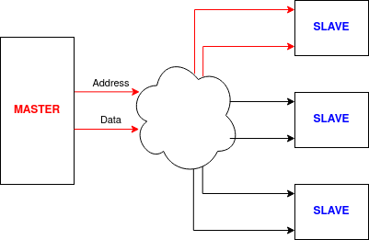
What it does
Two ways to communicate:
Read
Write
AXI has the role to enable such connections
<number>
Notes:
Course name
Lesson name
© 2000 - Author's name
<number>

Slide 4
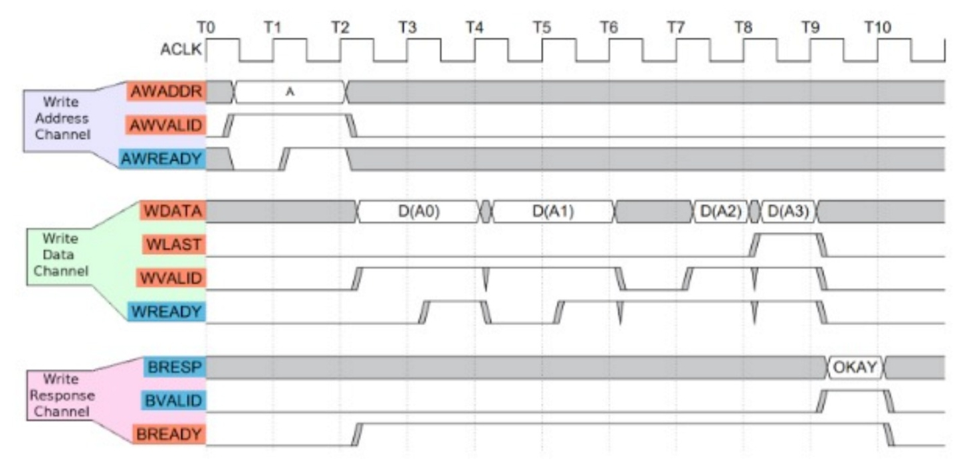
How does it do it
Address mapping
Handshake protocol:
For each line (address, data and BRESP); valid ready resp
<number>
Notes:
Course name
Lesson name
© 2000 - Author's name
<number>

Slide 5
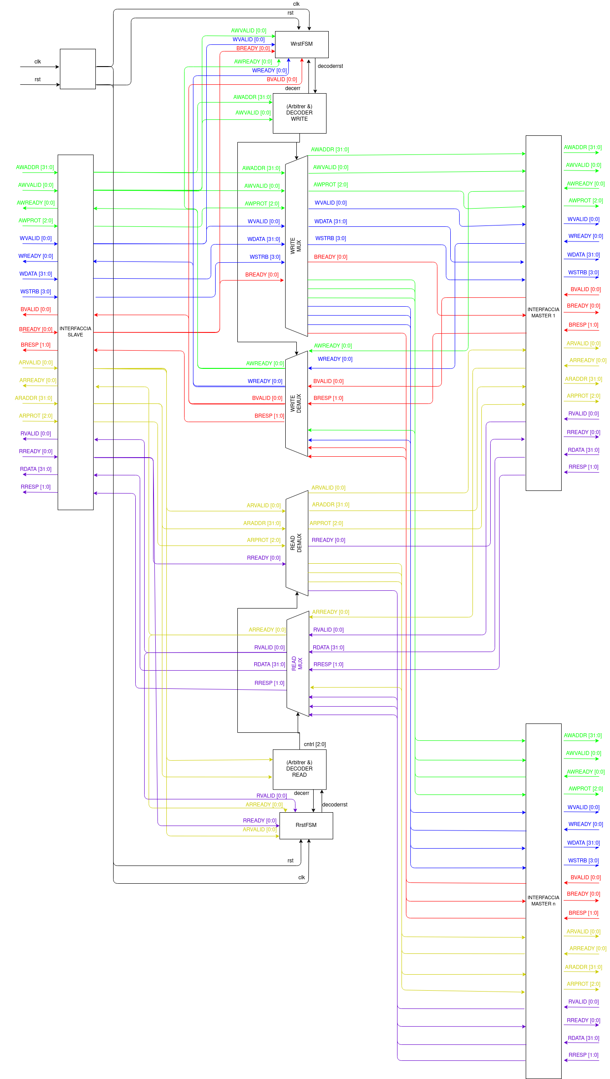
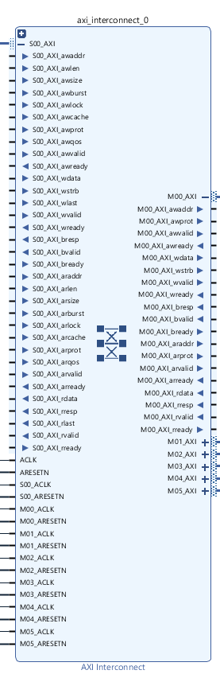
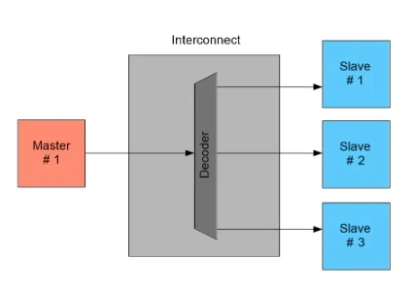
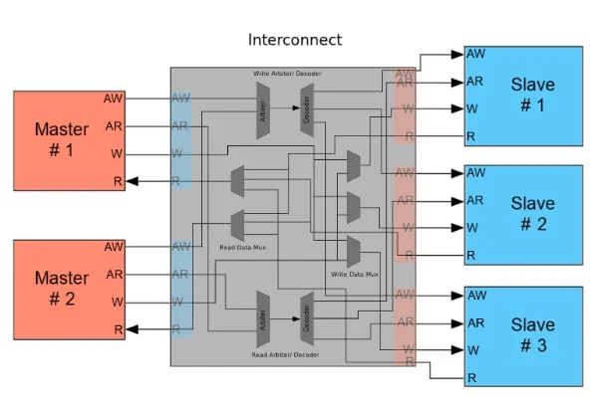
How it’s made
https://www.allaboutcircuits.com
<number>
Notes:
Course name
Lesson name
© 2000 - Author's name
<number>

Slide 6
Let’s break the magic
How to connect
Master to Slave
Slave to Master
The MUX and DEMUX need to be driven in some way… How? Let’s go on
DEMUX
MUX
<number>
Notes:
Course name
Lesson name
© 2000 - Author's name
<number>

Slide 7


The helm
To who belongs this address to?
DECODER
When is the address valid? When does the connecction end?
FSM
<number>
Notes:
Course name
Lesson name
© 2000 - Author's name
<number>

Slide 8
FSM States
ERR STATE
ADDR HS
IDLE
DATA HS
RESET
RESP HS
<number>
Notes:
Course name
Lesson name
© 2000 - Author's name
<number>

Slide 9

The Final Recepit
Finally, to build our AXI we used:
1) Big MUXs and DEMUXs
2) Sequential Circuits (decoder’s mapper)
3) FLIP FLOPS (to keep the signal of decoder)
4) FSM
5)Lot of patience 6) Love q.b.
<number>
Notes:
Course name
Lesson name
© 2000 - Author's name
<number>

Slide 10

On the AXI
IDLE
RESP HS
ADDR HS
ERR STATE
DATA HS
Standard Case:
Handshake on Address
Handshake on Data
Handshake on Response
Error Case:
Error on the Decoder
Switching to DE/MUX states
Completing the transaction with resp = 111
<number>
Notes:
Course name
Lesson name
© 2000 - Author's name
<number>

Slide 11
Difference Between AXI(s)
Features of AXI-Lite:
Burst length = 1
Always use full width of the data bus
All accesses are Normal, Non-modifiable, Non-bufferable
Multi-size registers can be implemented
Need In Order transactions
Do not support Quality of Service
Features of AXI:
Burst transaction (AxLEN, AxBURST, xLAST)
Different width of the data bus (AxSIZE)
Different type of accesses (AxLOCK, AxCACHE)
Multi-size registers can be implemented (xSTRB)
Support Out of Order transactions
Support Quality of Service
<number>
Notes:
Course name
Lesson name
© 2000 - Author's name
<number>

